Slide 1
Relational Database Design
Date of Presentation: 6/22/2023

Slide 2
Lesson 8:
Boyce-Codd Normal Form
(BCNF & 4NF)
Gerald Balekaki

Slide 3
Outline
More Normal Forms
Conversion to BCNF
Conversion to 4NF
Example:
ER design and normalization problem
Conclusion

Slide 4
Conversion to BCNF
BCNF Requirements:
A relation is in BCNF if, and only if,
every determinant is a candidate key.
When table contains only one candidate key,
the 3NF and the BCNF are equivalent.
However, BCNF can be violated only when table contains more than one candidate key.
BCNF is a special case of 3NF.

Slide 5
Example: Conversion to BCNF
Steps:
Step 1: Identify the dependencies which violates the BCNF
Consider X – > A as the FD that violate BCNF in R (ABCD)
Decompose R into R1(XA) and R2(BCD)
R1 is formed by combining the determinant with its dependent
R2 is formed by removing the dependent from the original R
i.e., R(ABCD) - {A} = R (BCD)
Step 2: Validate if both the decomposition are in BCNF or not
check if R1 has one candidate key
check if R2 has one candidate key
else repeat STEP 1&2 until relations are in BCNF

Slide 6
Example: Conversion to BCNF
Consider the relation R = (A, B, C, D, E) with
FDs = {
BC – > ADE
D --> B
}
Does the relation violate the 3NF/BCNF? if it does, show the steps to remove the violation.
Candidate Key for this relation is BC.
Prime attributes: BC
Non Prime attributes: ADE
BC -> ADE
(Full Dependency – ADE is fully dependent on candidate key)
D -> B
(nontrivial Dependency : non prime determines part of the candidate key)
So, D -> B violates BCNF, apply the following:
Decompose the relation R into DB & R-{B} (R minus B).
R1=(DB) B is dependent on candidate key
R2 = R(ABCDE) - {B} =R(ACDE) AE is dependent on candidate key

Slide 7
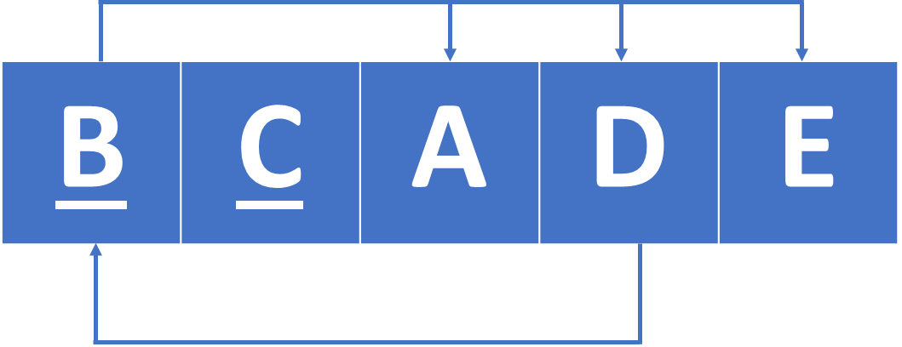
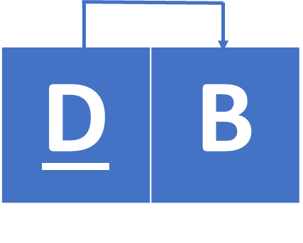

Example: Conversion to BCNF
Consider the relation R = (A, B, C, D, E) with
FDs = {
BC – > ADE
D --> B
}
Does the relation violate the 3NF/BCNF? if it does, show the steps to remove the violation.
Decomposition
R1=(DB)
B is dependent on candidate key
R2 = R(ABCDE) - R(B) =R(ACDE)
AE is dependent on candidate key
R
nontrivial dependency
R1
R2

Slide 8
Fourth Normal Form
(4NF)
Gerald Balekaki

Slide 9
Conversion to 4NF
4NF concerns the removal of multi-valued dependency (MVD)
Definition:
Multi-valued dependency:
For A -->--> B, if for a single value of A, multiple values of B exists, then MVD.
A1 – > B1,B2
a table should have at-least 3 columns for it to have a MVD.
MVD not in R(AB), but exist in R(ABC)
WHY? violation can be removed in R(AB) to become
R( A B
A1 B1
A1 B2)
For R(A,B,C), if there is a MVD between, A and B, then B and C should be independent of each other.

Slide 10
Conversion to 4NF
4NF Requirements:
A relation is in 4NF if, and only if,
a table is on BCNF
for every nontrivial multi-valued dependency A -->--> B,
A is a candidate key of the relation.
there's no multiple sets of multivalued dependencies.
Note
4NF and beyond, are largely academic if tables conform to:
all attributes are dependent on a primary key, and independent of each other
so rare to find non-trivial dependencies not dependent on a candidate key.
no row contains two or more data values
Relations in 3NF is sufficient normalization for any business transaction, 4NF and beyond, are not always most desirable.

Slide 11
Example: Conversion to 4NF
R = (A, B, C, G, H, I)
F ={ A -->--> B
B -->--> HI
CG -->--> H }
R is not in 4NF since A -->--> B and A is not a superkey for R Decomposition
(ACG is candidate key)
a) R1 = (A, B) (R1 is in 4NF)
b) R2 = (A, C, G, H, I) (R2 is not in 4NF, decompose into R3 and R4)
c) R3 = (C, G, H) (R3 is in 4NF)
d) R4 = (A, C, G, I) (R4 is not in 4NF, decompose into R5 and R6)
A -->--> B and B -->--> HI A -->--> HI, (MVD transitivity), and
hence A -->--> I (MVD restriction to R4)
e) R5 = (A, I) (R5 is in 4NF)
f) R6 = (A, C, G) (R6 is in 4NF)

